Slide 1
OFFLINE CAB SERVICE USING AI
510616205019 MOHAMMED NASHID MIFZAL P (16519)
510616205008 DINESH.V (16508)
510616205014 Kafeel Ahmed T M(16514)

Slide 2
ABSTRACT:
The transport industry of India has seen a tremendous boom over the past decades with more service providers entering the market, providing efficient services to the people.
The competition has increased with the introduction of on-demand cab services such Ola, Uber, etc. The customers are now able to avail the service right from their location by booking through online portals.

Slide 3
ABSTRACT (cont.….)
As a developing nation, the outreach of technology is lesser when compared with the geographical aspects.
We still have larger communities unable to avail the internet-based services. We see that as a problem to those communities in availing services available.

Slide 4
INTRODUCTION
We propose an efficient and simple AI based cab service which would work using the concept of neural networks.
Our service is concentrated towards feature phone users and users with no internet access.
The customer can call to a fixed cab service number and book the service in a minute by answering a few questions.
The intelligent machine will interact with the customer in their regional language and provide the obtained travel details to the nearest driver and make the commutation easy and simple.

Slide 5
LITERATURE SURVEY
TITLE: E-RNN:DesignOptimizationforEfﬁcientRecurrentNeuralNetworksinFPGA.
Author: Zhe Li, Caiwen Ding, Siyue Wang, Wujie Wen.,
University, 2Northeastern University, 3Florida International University
from “ MCA department IMR Jalgaon, North Maharashtra University Jalgaon, MS, India.
Description: ADMM-based training for deriving block-circulant matrice-based RNN representation. We present the E-RNN framework for FPGA implementations of the ASR application. The overall goal is to improve performance/energy efﬁciency under accuracy requirement. We start from two design explorations providing guidance on block size and reducing RNN training trials. Based on the two observations, we decompose E-RNN in two phases: Phase I on determining RNN model to reduce computation and storage subject to accuracy requirement, and Phase II on hardware implementations given RNN model. We explore on both LSTM and GRU using the proposed E-RNN and we provide comprehensive comparisons with ESE and CLSTM.
5

Slide 6
(Cont....)
TITLE: Speech recognition enhancement using beamforming and a genetic algorithm.
Author: Parikshit Awasarmol,Aditya Amberkar, Gaurav Deshmukh, MCT’s Rajiv Gandhi Institute of Technology, Mumbai, Maharashtra.
Description: RNN is one of the best algorithm used for processing of speech signal and it has scope in emerging voice controlled technologies but training algorithm is again very complex .It shows better results than Multilayer perceptron(MLP).Speech recognition has attracted many scientists and researchers and can be influential to society in emerging technologies.
6
6

Slide 7
(Cont....)
TITLE: Speech recognition enhancement using beamforming and a genetic algorithm.
Author: K.Y. Chan Digital Ecosystems and Business Intelligence Institute, Curtin University of Technology, Perth, Australia.
Description: A new speech enhancement method, which uses GA to optimize the performance of beamformer, has been proposed to directly maximize speech recognition accuracy. It compensates the deficiencies of the existing enhancement methods, which is designed for minimizing signal distortion or maximizing noise suppression, but cannot directly deal with speech recognition accuracies. The performance of the proposed method is evaluated by using a pre-trained recognizer embedded with two sets of speech commands.
7
7

Slide 8
EXISTING SYSTEM
CAB BOOKING NOW A DAYS
Now a days the cab booking is usual for the smartphone users, but not the featured phone users.
Yes, the featured phone users can call some taxi service available but they are human operated.
This human interaction makes this process little tedious.

Slide 9
PROPOSED SYSTEM
FOR FEATURED PHONE USERS (BUTTON TYPE PHONES):
The users might be able to Book Cab using their basic mobile ,they should make a call to a Toll-free number.
An Artificial Intelligence BOT will handle your call.
Give their sources address (for verification) and Destination address.
The driver will be at your location in few minutes.

Slide 10
PROPOSED SYSTEM
FOR SMART PHONE USERS:
The smart phone users will have a Mobile app which will have enough information for the customer to book a Cab.
The DRIVER will be having an app to know the geolocation of the user who is calling them.
The App will be playing a typical role as usual for the user.

Slide 11
ADAVANTAGES
The Featured phone users can also have the CAB booking service .
The Smart phone users who have poor Internet Connection can also have the CAB booking service.
User friendly system very easy to use.
Low knowledge users can also be a benefits.

Slide 12
EXISTING SYSTEM VS PROPOSED SYSTEM
The Smart phone users who have Internet Connection will be using the cab booking service .
The user will be required to have active internet connection.
CAB booking service with calling service available with customer care executive
The Featured phone users who dont have Internet Connection will also be using the cab booking service .
The user not required to have active internet connection.
CAB booking service with calling service available with AI Speech .

Slide 13
SYSTEM REQUIREMENTS
Software Requirements
TWILIO
Twilo-Programmable Voice
Twilo-Programmable SMS
TwiML
Twilo-Programmable Voice
REST API
ARTIFICIAL INTELLIGENCE
Reccurrant Neural Network
Speech Recognition using RNN

Slide 14
SYSTEM REQUIREMENTS (Cont....)
Software Requirements
PYTHON
Features of Python
Applications
Selenium Library
Hardware Requirements
Beagle Bone Black

Slide 15
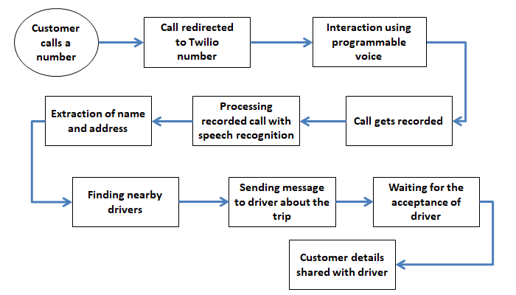
SYSTEM ARCHITECHTURE

Slide 16
MODULES OF PROPOSED SYSTEM
CUSTOMER CALL TO A TOLL-FREE NUMBER
RECORDING OF THE CONVERSATION
PROCESSING OF THE RECORDED CALL
TRANSCRIBING OF RECORDED CALL
ADDRESS EXTRACTION
MATCHING DRIVER WITH CUSTOMER

Slide 17
MODULES OF PROPOSED SYSTEM
CUSTOMER CALL TO A TOLL-FREE NUMBER
Twilio’s trial service is deployed in this project as the main channel through which the customers without internet and feature phone users can avail the service. The toll-free number is given to the customer to avail the services offered.
The specified number to avail the service is: +1 201-654-6959.
RECORDING OF THE CONVERSATION
TwiML consists of various functions or blocks that can be used in constructing of the application. It can be deployed in our application with just a few lines of code.

Slide 18
MODULES OF PROPOSED SYSTEM
PROCESSING OF THE RECORDED CALL
The recorded phone call stored in the Twilio Database is extracted using Selenium Library, with the help of Python programming language.
Using the algorithm, the process of extraction of phone call from the database is automated to have a real-time track of customer’s phone calls.
The below figure shows the downloading of the customer’s phone call, which is stored in our server.
TRANSCRIBING OF RECORDED CALL
With the recorded phone call on our server, it is passed on the speech recognition model, to convert the speech to text.
The Pre-trained model of Google Recognizer is employed in the model as it yields better efficiency. However, to improve the efficiency, separate trained model with the raw data available online can be used.
The figure shows the transcript of the recorded phone call. It is then passed for the next step of address extraction.

Slide 19
MODULES OF PROPOSED SYSTEM
ADDRESS EXTRACTION
The transcribed phone call is further processed for the extraction of pick-up address of the customer.
The below figure shows the extracted pick-up address of the customer that is to be sent to the driver.
MATCHING DRIVER WITH CUSTOMER
Driver locations are tracked in real-time by getting the location of drivers using GPS and support of smartphones.
An algorithm is constructed to match the location of the driver and customer. The nearby driver to the customer is matched and the pick-up address of the customer is sent through Twilio’s Programmable SMS to the driver.

Slide 20
CONCLUSION
The Artificial Intelligence based Cab booking service eases the cab booking process of offline smartphone users and feature phone users by employing latest technologies. It makes the customer to avail the service available – only for online smartphone users.

